Slide 1
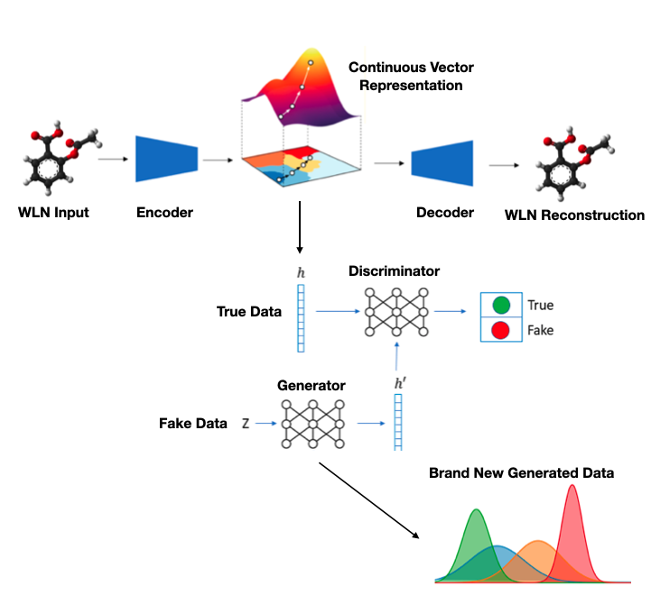
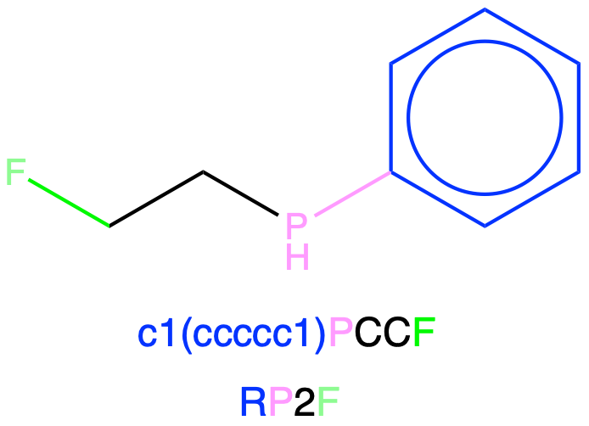
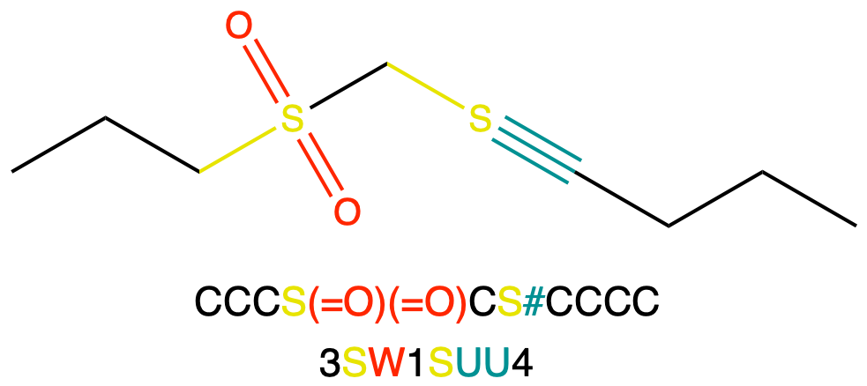
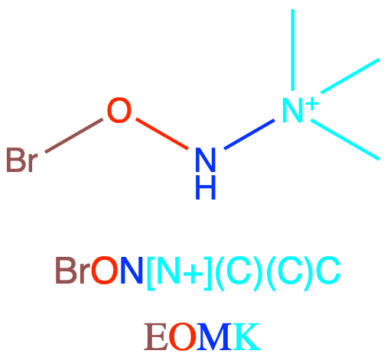
Zombie Cheminfomatics -
Dead languages that refuse to stay dead
Presentation Topics
Re-evaluation of the WLN Reader
Smiles to WLN Neural Translation
Molecular Generation With WLN - Variational Autoencoders & GAN’s
Chemical Descriptor Regression Experiment - Delaney
Why should WLN continue? - Graph Representation Learning
Jeremy Frey
Michael Blakey
The Frey Research Group
University of Southampton

Slide 2
Re-evaluating the WLN Reader
Mistakes fall in 5 main categories
- Fused rings > 2 - Aliphatic/aromatic ring mixes - Spiro Rings - Ring Bridges - Expanding Charge Valence
Reader Score revised to 87%
We only corrected the data!
Smaller Categories are very easily fixable
- Ring Phosphorus - Some elemental metals missing
L666 N6 B6 R6 Q6 4ABRS C&J
L66 &TJ
L6XTJ A-& AL5XTJ
L55 ATJ
QGO&O &-KA-
QSUS&Q &-NA-

Slide 3
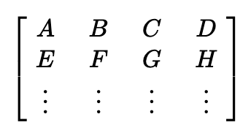
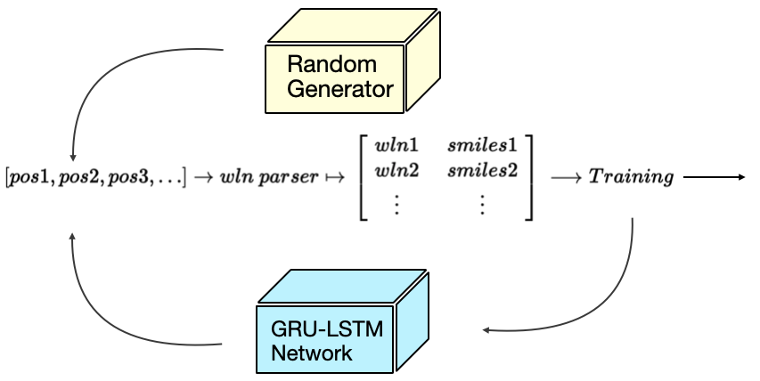
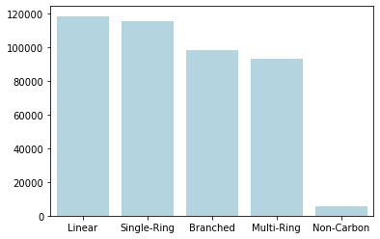
Data Augmentation
Ring Augmentation - a wln writer from graphs
For any AI Techniques, we needed a lot of data
A2E
DPUO
Wln Characters
B8G
KQ
B2Z

Slide 4
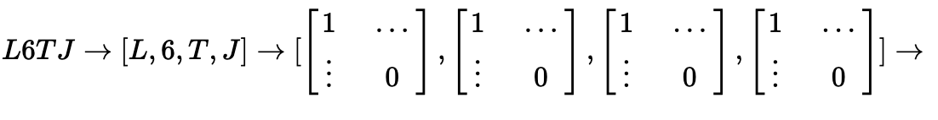
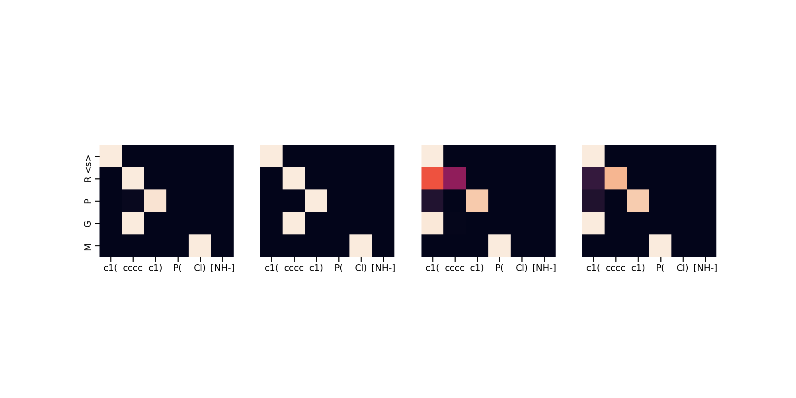
Smiles to WLN Neural Translation
Wln parser + transformer
96% translation on Pubchem set
We needed a way to capture the other ring systems in Pubchem

Slide 5
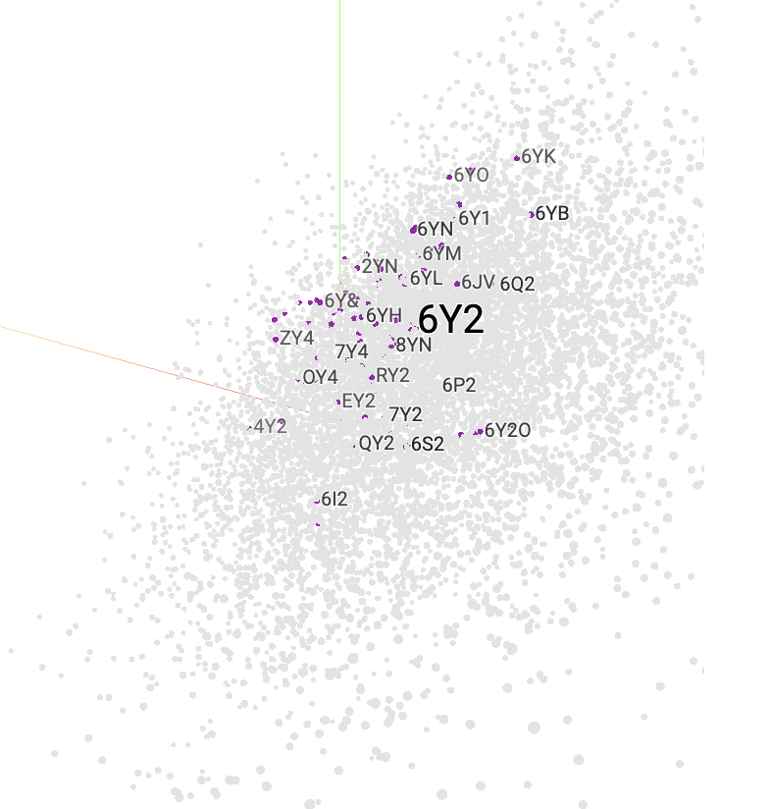
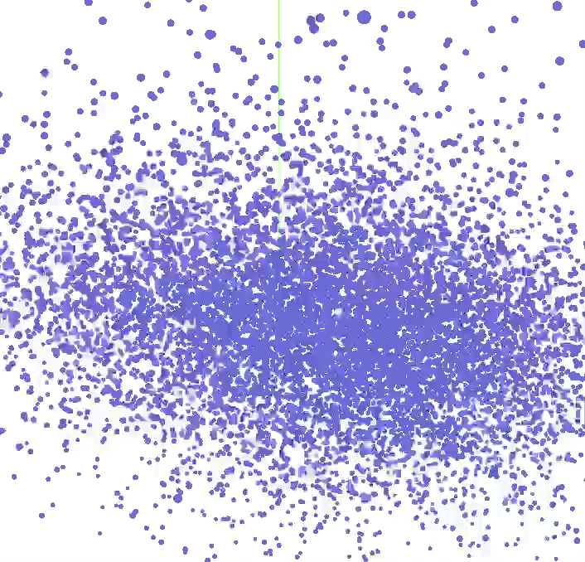
Molecular Generation With WLN - Variational Auto-encoders & GAN’s
Creation of a 512 dim vector representation

Slide 6
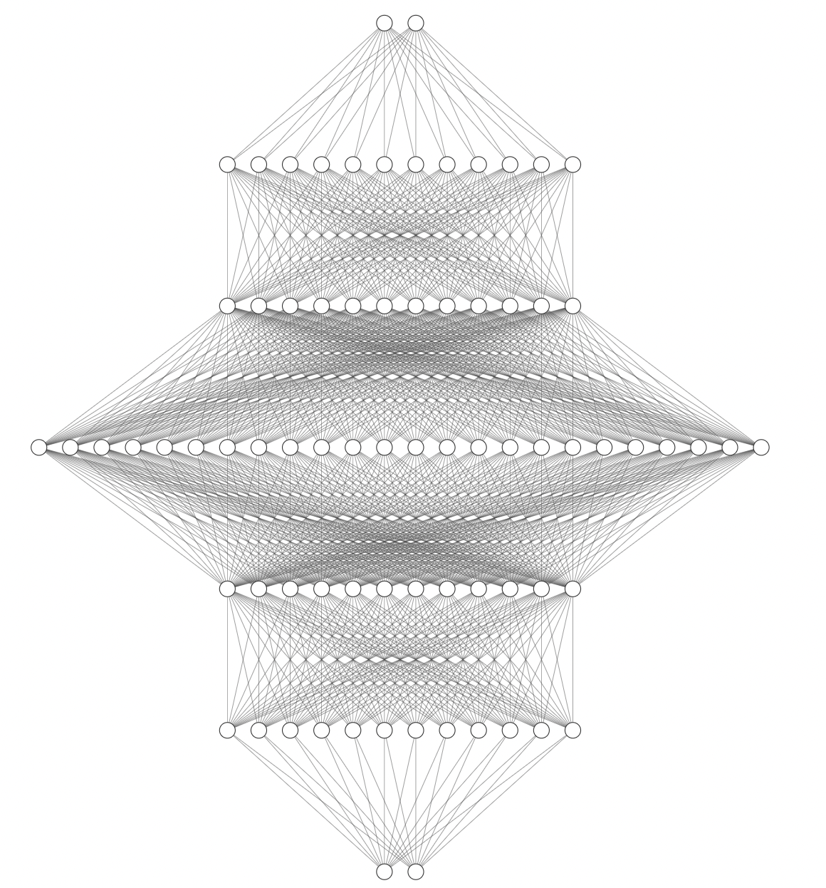
A Hint at Unreasonable Efficiency - Dual VAE
Smiles
Wln
“ All SMILES Variational Autoencoder ”
“ All SMILES Variational Autoencoder for Molecular Property Prediction and Optimization ”
“ VAE-Sim: a novel molecular similarity measure based on a variational autoencoder ”
Accuracy Lines eventually meet at >99% Accuracy for both Smiles & WLN
Smiles
Wln

Slide 7
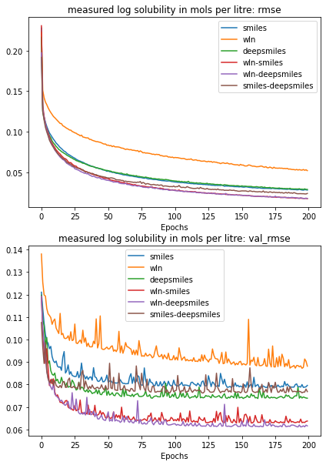
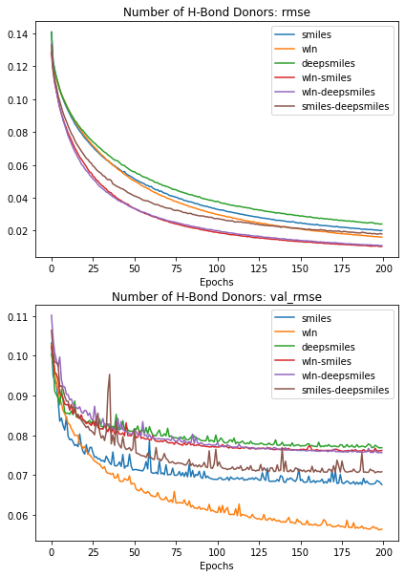
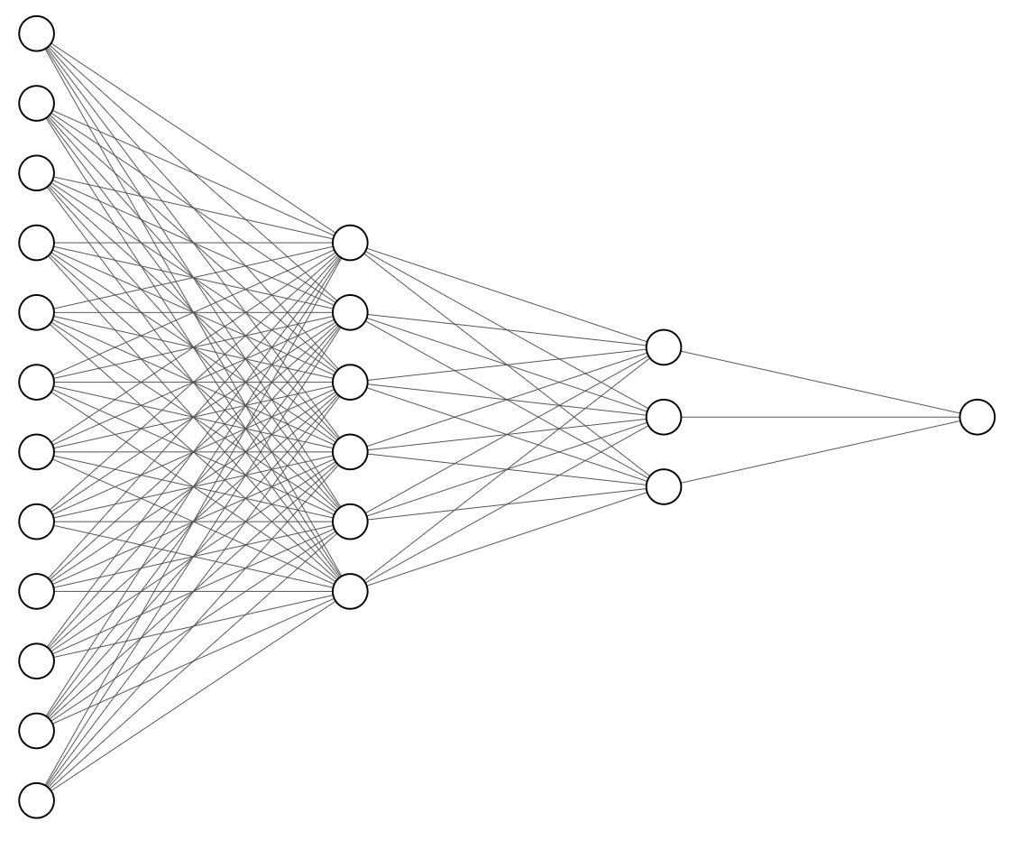
Chemical Descriptor Regression Experiment - Delaney
We recreated the Delaney data set to test property prediction
Smiles
Or/&
WLN

Slide 8
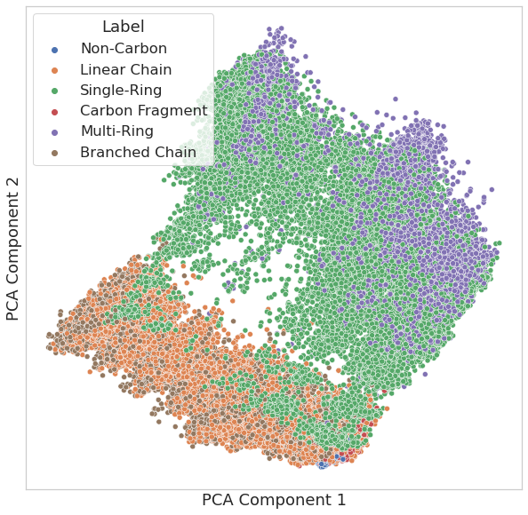
Why should WLN continue? - Graph Representation Learning
We wouldn’t usually just input a representation for prediction
However they are useful in structured learning!
The more information we have the better

Slide 9
Thank you for Listening
Happy to answer any questions about these Zombie notations!
Jeremy Frey
Michael Blakey
The Frey Research Group
University of Southampton

Slide 10
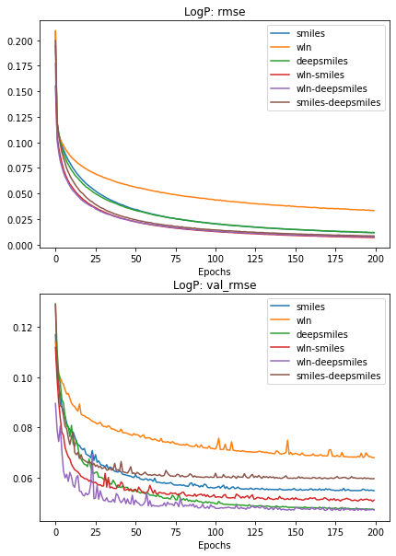
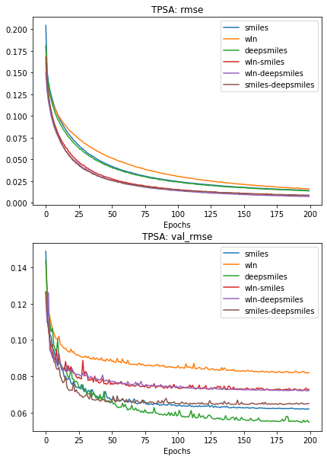
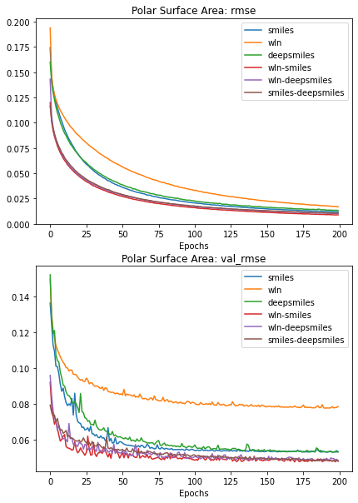
Other Descriptors

